Slide 1


DataCite
Presentation
Name Surname
21st of September 2021
Event name

Slide 2
DataCite
Chapter cover 01

Slide 3
DataCite
Chapter cover 02

Slide 4
“In order to make it more dynamic, we highlight pages as well as we highlight text.”

Slide 5

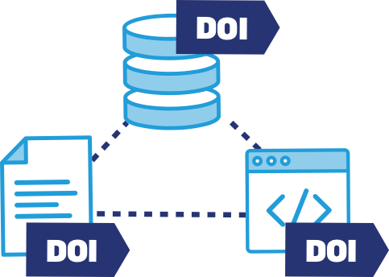



Our value
Registering DataCite DOIs makes
your research outputs discoverable.
DataCite services make it easy to follow best practices.
DataCite services help you track and report on your research.
· A DOI makes your research outputs uniquely identifiable.
· Metadata that you register with DataCite is in a central location, harvestable by anyone.
· Metadata for our Members’ research outputs appear in other search engines.
· We make research data management easy: you register your first DOI in less than 1 minute.
· DataCite DOIs and metadata help you make your research FAIR.
· We connect you to the DataCite Member community, which is full of passionate people who share experience and continue to support best practice.
· Our metadata schema is extensive and has been adopted by other PID service providers globally.
· A DOI enables easy tracking of your research outputs through simple user interfaces.
· DataCite services make institutional reporting simple.
· DataCite services support data citation and usage analytics

Slide 6





Our community
600+
Organizations
2000+
Repositories
238
Members
43
Countries
20m+
DOIs

Slide 7
About DataCite
Global non-profit membership organization
working with 2100+ repositories in the world
to provide DOIs for data and other research outputs.
https://datacite.org/

Slide 8


About DataCite
Global non-profit membership organization working with
2100+ repositories in the world to provide DOIs for data and
other research outputs.
https://datacite.org/

Slide 9

Connecting research,
identifying knowledge

Slide 10
Types
of research outputs
DATACITE DOIs ARE SUITABLE FOR A WIDE RANGE OF RESEARCH OUTPUTS
1. Research datasets and collections, associated workflows, software, images, and models
2. Grey literature such as theses, dissertations, reports, unpublished conference papers, newsletters, preprint journal articles, technical standards, and specifications for which the institutional repository is the primary publication point.

Slide 11
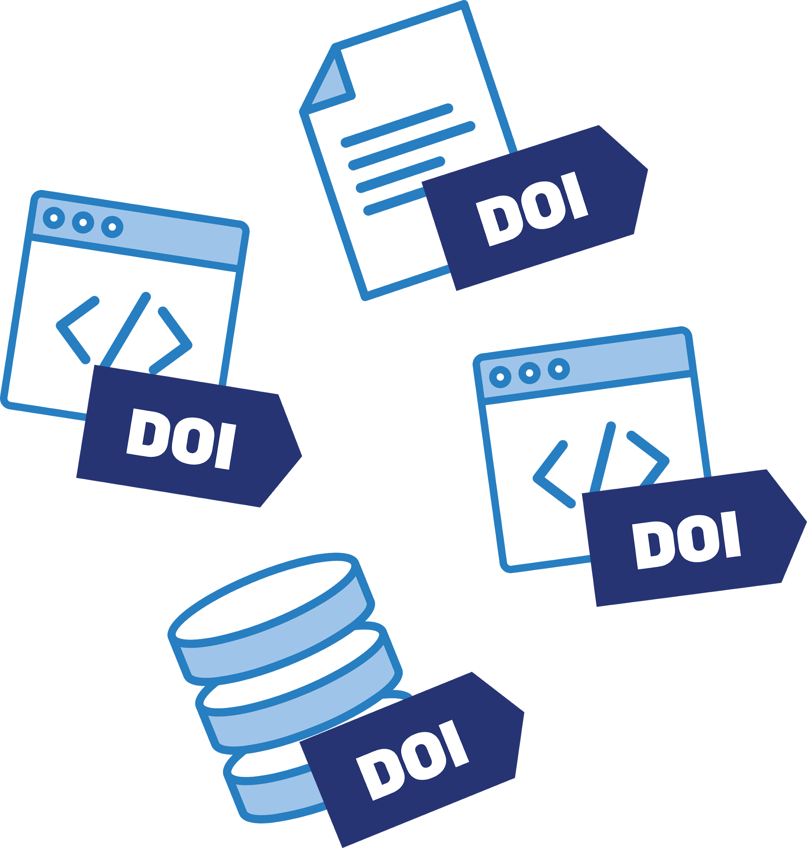
Create
and Manage DOIs
DataCite membership allows you to create and manage DOIs for all of your repositories. You can do this through:
· Our primary REST API that supports JSON and enables automated DOI registration
· Our manual interface that enables you to register DOIs in less than a minute.
· Registered DataCite Service providers that provide a platform where you can register DOIs.

Slide 12
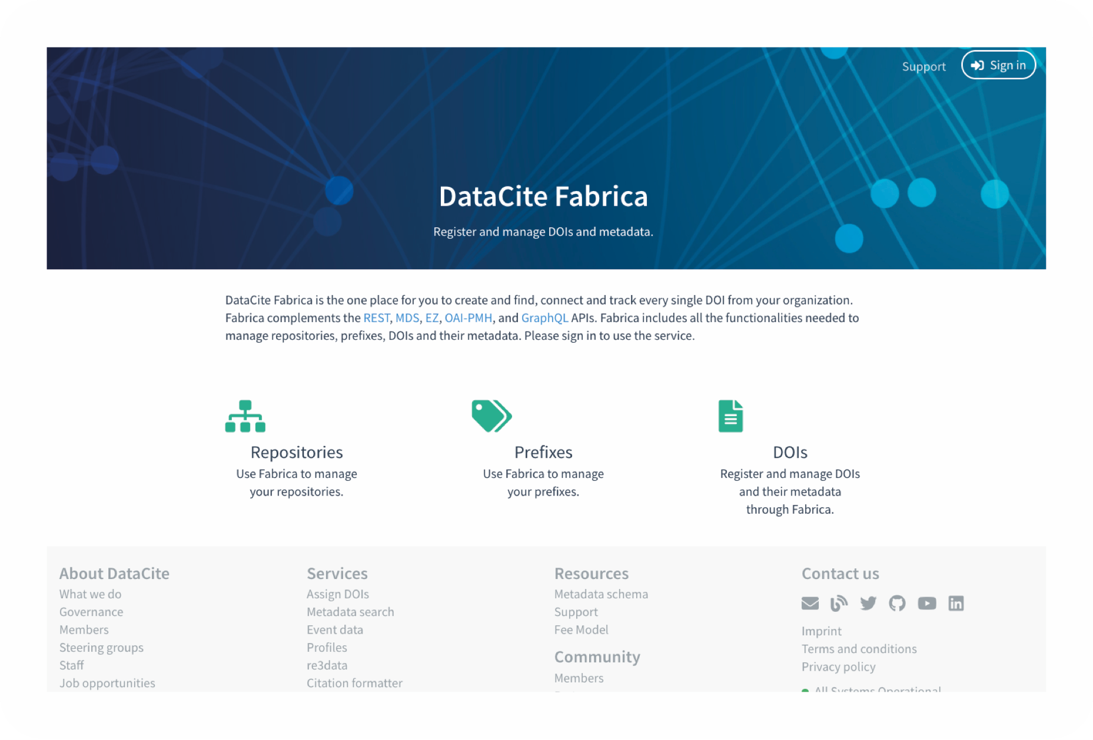
DOI
web interface
ONE-STOP SERVICE TO CREATE
AND MANAGE DOIs FOR YOUR ORGANIZATION
1. Tools to create, manage, and find DOIs and metadata
2. Statistics on DOI activities
3. Link checker information
4. Maintain organization information

Slide 13
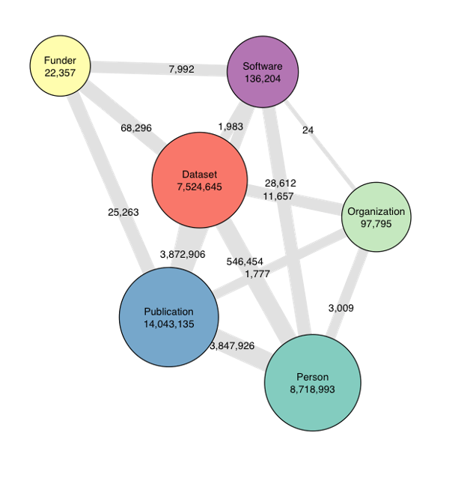
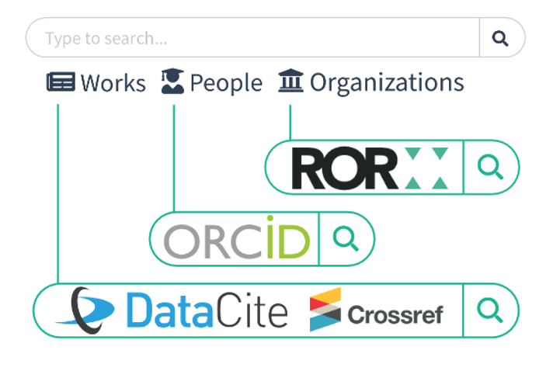
Find and Connect Research
Find Research
with DataCite Commons
PID Graph
Number of nodes and connections (08 MAY 2020)

Slide 14
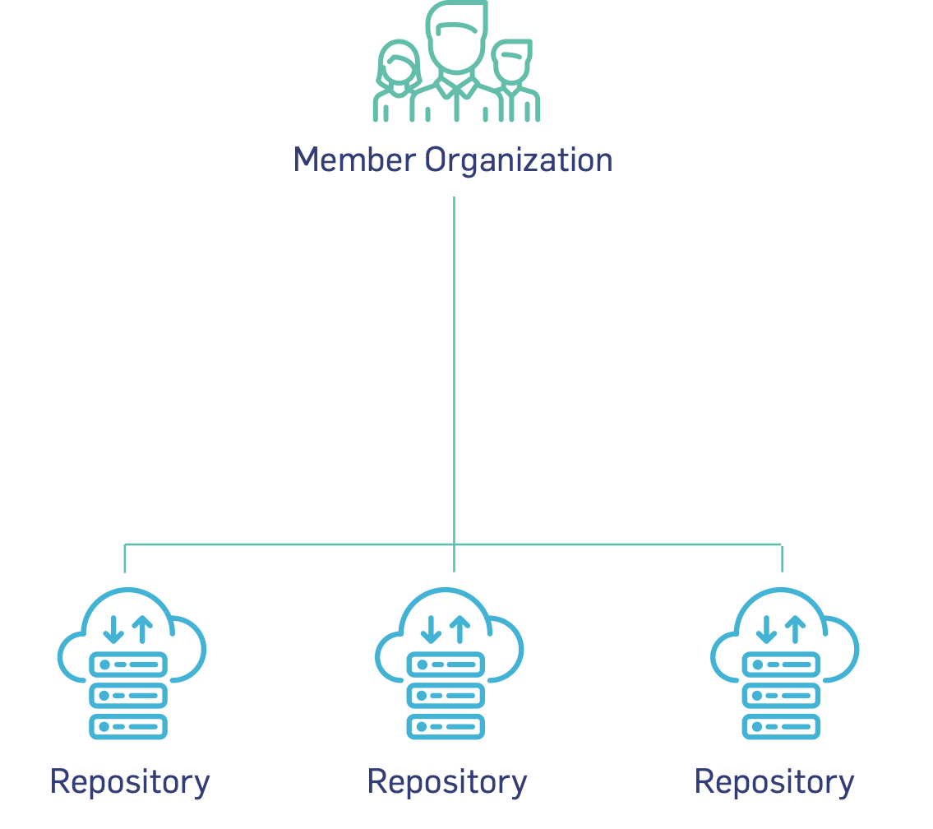
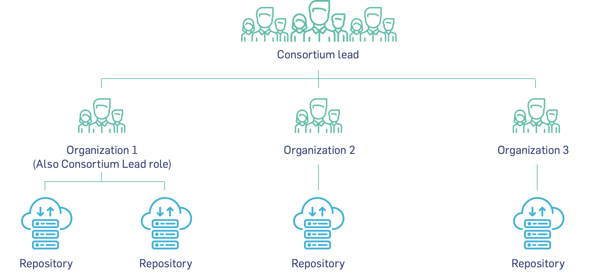
DataCite
Membership
Direct Membership
Consortium Membership

Slide 15







Get in touch!
Emial us:
info@datacite.org
Follow us:
@datacite
Talk to us:
pidforum.org
Read about us:
datacite.org
Get support:
support.datacite.org
support@datacite.org

